Slide 1

Final Term Project week 12
Erwin T. Hammock
Bellevue University

Slide 2

In this presentation, we will explore a statistical question and hypothesis related to supermarket sales data. We will identify the factors that might influence sales and develop a plan to test our hypothesis. By analyzing this data,
This Photo by Unknown Author is licensed under CC BY-SA
Notes:
Questions 1: Does Growth Income impact sales growth
Questions 2: Does customer rating impact sales growth
These are some variables we would analyze and explore to see how much do they impact sales growth in super market
Step 1: Read data
Step 2: Get information on the data variables
Step 3: Descriptive analysis
Step 4 and 5: Breakdown the disibutions of variables in the data set (Bivariate Analysis)
Step 6: Analyze Relationships between variables
Step 7: Regression analysis

Slide 3
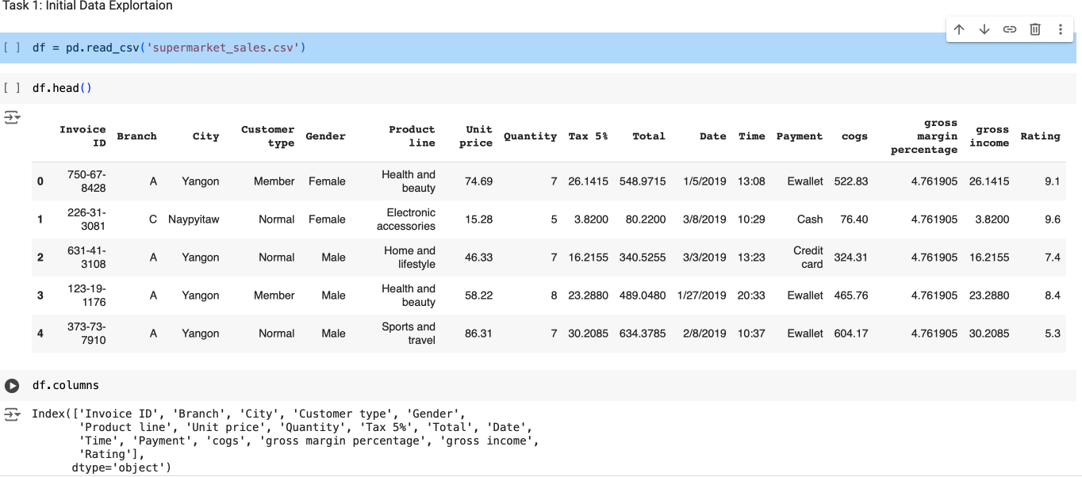
After importing libraries now we want to read the data and explore the variables in the data set.

Slide 4
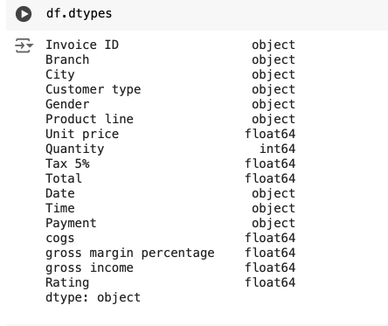
List of the top five variables Rating Total quantity gross income gender
Notes:
Data types

Slide 5
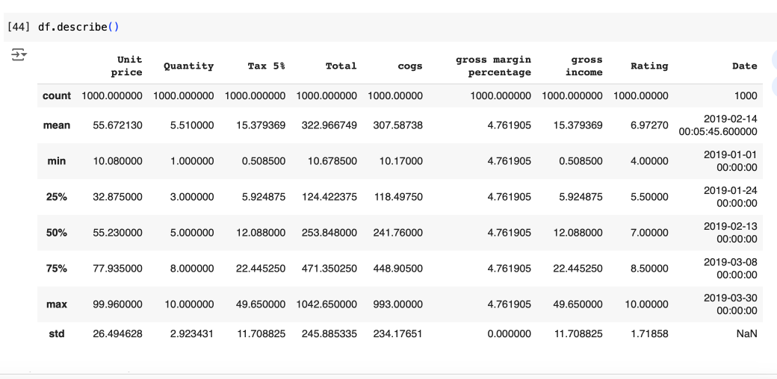
Descriptive analysis
Notes:
Mean: The average value of each numerical column in the dataset. For example, the Unit price column has a mean of 55.67. This signifies that the average unit price across all products sold is around $55.67.
Spread: The variability of the data in each column. There are two common ways to measure spread:
Range: The difference between the highest and lowest values in this column. For instance, the Unit price ranges from $10.08 to $99.96.
Standard deviation: A measure of how spread out the data is from the mean. A lower standard deviation indicates that the data points tend to be closer to the mean, while a higher standard deviation suggests more variation from the mean. In this dataset the standard deviation for Unit price is $26.49.

Slide 6
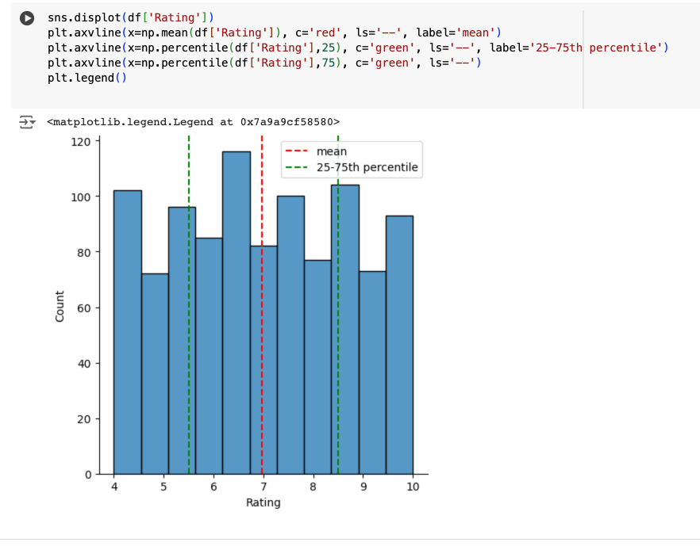
Ratings
Notes:
The Histogram looks like a normal. It seems to be no skewed either left or right direction.

Slide 7
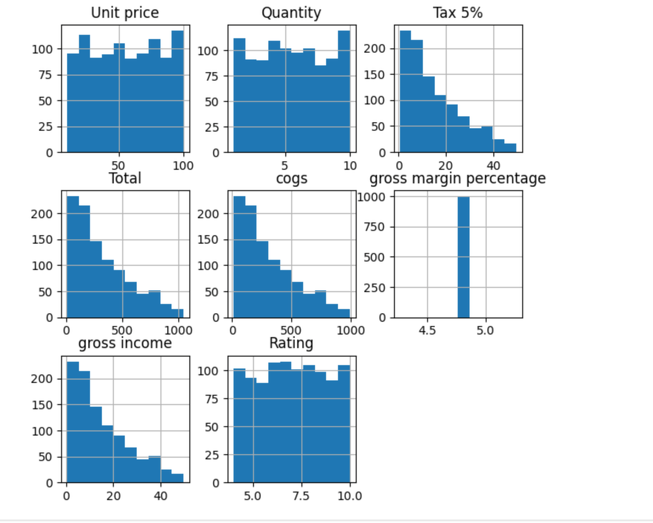
Other top variables we want to analyze.

Slide 8
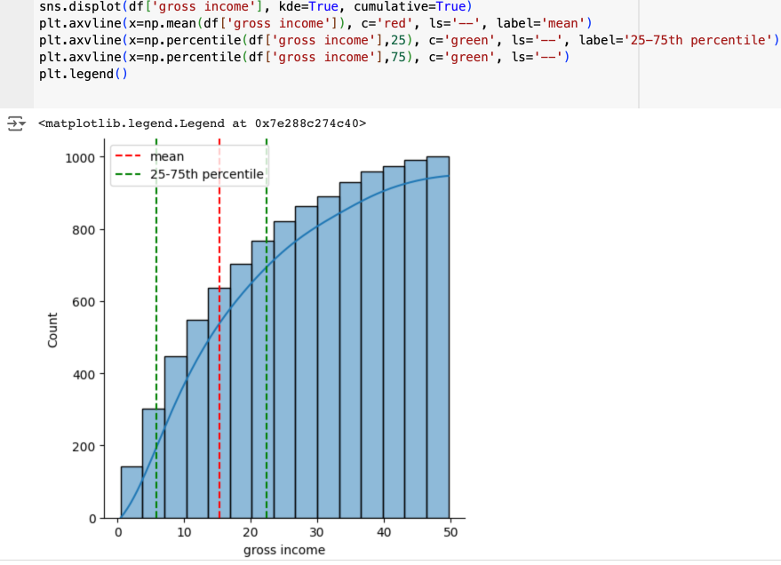
CDF Analysis on Gross Income
Notes:
The red line in the graph intersects the y-axis at about 0.6. This means that there is a 60% chance that a data point in the dataset will have a gross income of less than or equal to the value of the x-axis where the two lines intersect (which is about $800).
The green line shows the 25th and 75th percentiles of the data. The 25th percentile is the value below which 25% of the data points fall. The 75th percentile is the value below which 75% of the data points fall. The area between the two green lines represents the middle 50% of the data.
The impact of grass income on supermarket sales is a complex issue and there is no easy answer. However, it is likely that there is a positive correlation between the two. In other words, as grass income increases, supermarket sales are also likely to increase. This is because people with more money are likely to spend more money on groceries.

Slide 9
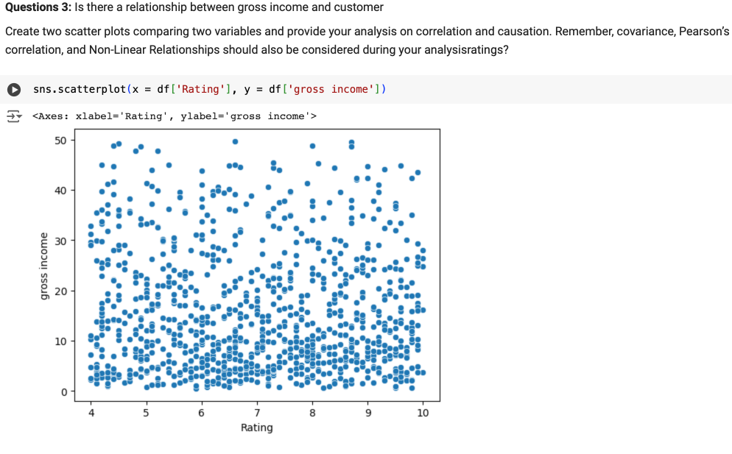
Is there a Relation between gross income and rating
Notes:
Distribution of Points:
The points are scattered across the entire range of Rating and gross income.
There does not appear to be a strong linear relationship between Rating and gross income as the points are widely spread out in the vertical direction for each value of Rating.
Trend Analysis:
There is no clear upward or downward trend that would suggest a positive or negative correlation between Rating and gross income.
The gross income values are relatively evenly distributed across different ratings.
Correlation:
Visual inspection suggests a very weak or non-existent correlation between Rating and gross income.
This can be further confirmed by calculating the Pearson correlation coefficient.
Variability:
Gross income shows high variability across all levels of rating.
This suggests that other factors may be influencing gross income more significantly than rating.

Slide 10
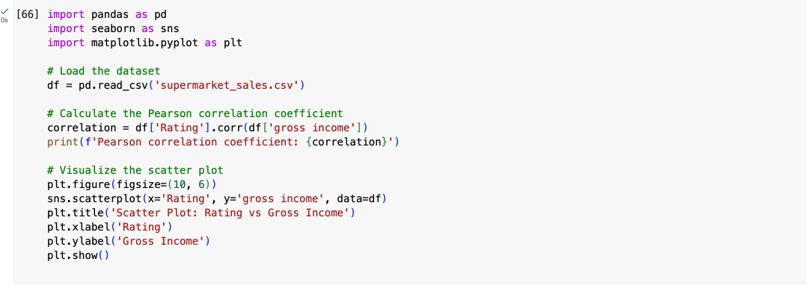
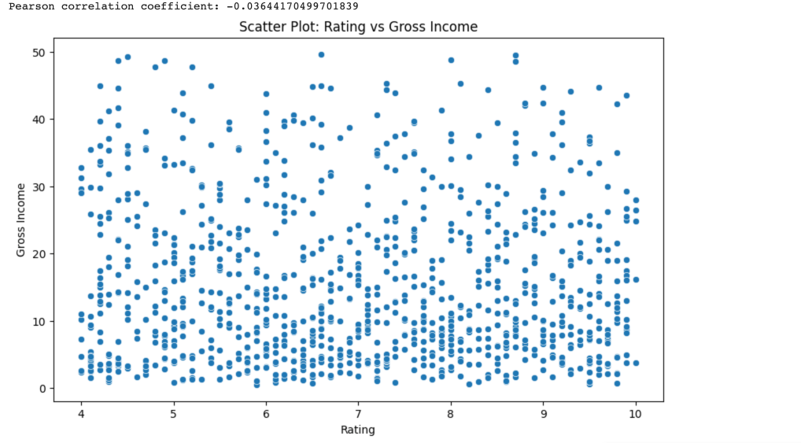
I did a statistical analysis to quantify the relationship between the two variables.
Notes:
Pearson Correlation Coefficient: If the calculated coefficient is close to 0, it confirms the visual observation that there is no significant linear relationship between Rating and gross income.
The calculation is close to 0 so there is no significant correlation, it suggests that customer ratings do not directly impact the gross income

Slide 11
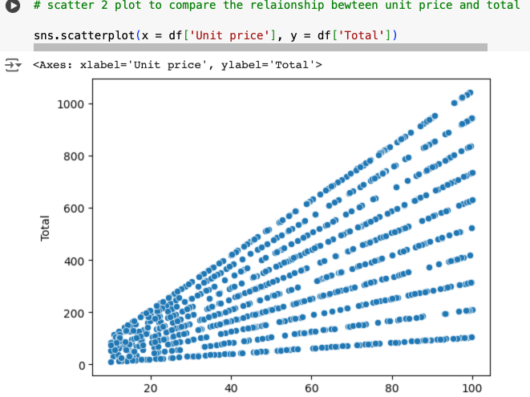
Unit Price Total
Notes:
We would expect to see a cloud of points with no clear linear relationship. This would indicate that there is no strong correlation between unit price and gross income. There may be some outliers, where a particular product with a high unit price is purchased by someone with a low gross income, but overall there wouldn't be a trend.

Slide 12
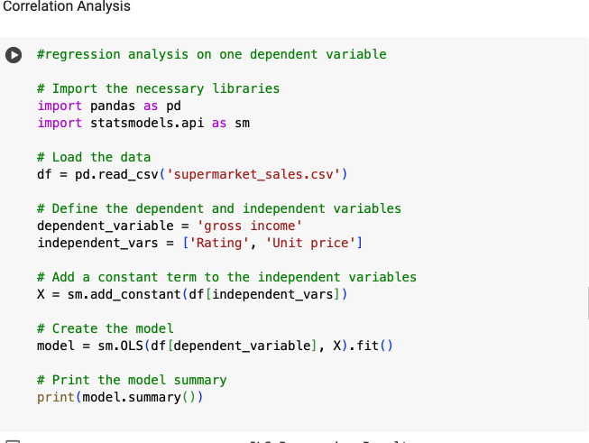
Regression analysis

Slide 13
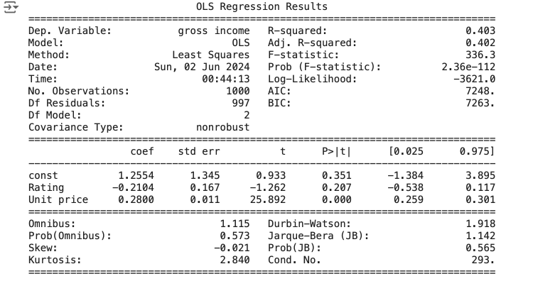
OLS Regression analysis The model explains approximately 40.3% of the variance in gross income. Unit price is a significant predictor of gross income, while Rating is not. The intercept is not statistically significant. The diagnostic statistics do not indicate major issues with normality or autocorrelation, although high condition numbers might suggest multicollinearity, but 293 is on the edge where concern starts.
Notes:
The model explains approximately 40.3% of the variance in gross income.
Unit price is a significant predictor of gross income, while Rating is not.
The intercept is not statistically significant.
The diagnostic statistics do not indicate major issues with normality or autocorrelation, although high condition numbers might suggest multicollinearity, but 293 is on the edge where concern starts.

Slide 14
Conclusion
Notes:
It seems to be no correlation between the variables and decided to analyze that impact sales growth
Seems be no trend in the data .
We will continue to investigate other variables for further analysis
Please let me know if you have any questions .

